Slide 1
SMART DUSTBIN WITH GSM AND ARDUINO MODULE
GOVERNMENT POLYTECHNIC AWASARI (KH.)
Project Partners:
1] Atul Dighe
2] Abhishek Revgade
3] Prathamesh Borkar
4] Sushant Bangar
Project Guide : Smt. J.J.Pathan

Slide 2
CONTENT
INTRODUCTION
PROBLEM STATMENT
FLOW CHART / CIRCUIT DIAGRAM
COMPONENTS / WORKING MECHANISM
COST ESTIMATION
CONCLUSION / FUTURE SCOPE
ADVANTAGE,DISADVANTAGE AND APPLICATION

Slide 3
INTRODUCTION
In city there are many public places where we see that garbage bins or dustbin are place but overflow. To avoid such situation we made a project.
Smart dustbin is carefully designed for cleanness of society and also reduced the human efforts.
It will use in public places like collages, hotels, parks, hospitals, industry's etc.
In the covid situation, it also helps to avoid the growth of the virus.

Slide 4
PROBLEM STATMENT
There are millions of public dustbin out there that people use and are emptied in a few days by the public authorities. Now the problem is not all dustbins are filled at the same rate and the dump vehicle waste time checking each and every dustbin. So the solution is a smart dustbin.

Slide 5
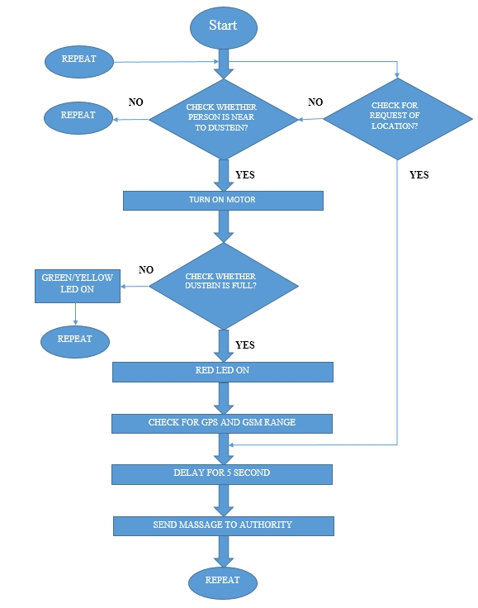
FLOW CHART

Slide 6
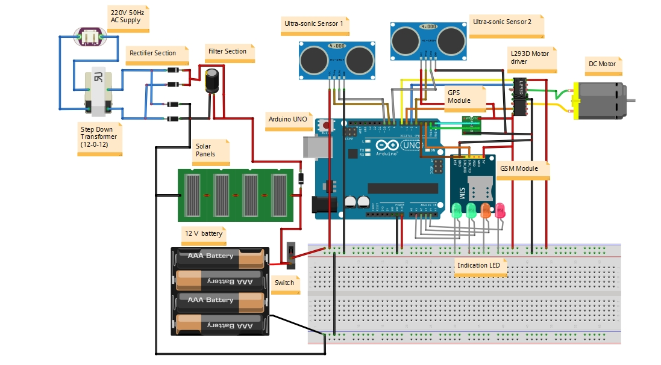
CIRCUIT DIAGRAM

Slide 7
COMPONENTS
ARDUINO UNO
GSM MODULE
GPS MODULE
ULTRA-SONIC SENSOR
MOTOR DRIVER
DC MOTOR
SOLAR PANELS
LED

Slide 8
WORKING MECHANISM
In this project the main part is controller that is Arduino board. I will connect different peripherals to the Arduino. There is two input peripherals to the Arduino that is Ultrasonic sensors which gives the input signal to the Arduino with respect to the input signal the Arduino operates the output peripherals that is GPS module, GSM module and Motor. When ultrasonic sensor 1 will detect the human near the dustbin it will give signal to the Arduino. When Arduino get signal from the ultrasonic sensor 1 the Arduino send signal to the motor driver with respect to the signal the motor driver will actuate the motor. When once complete the motor operation the ultrasonic sensor 2 automatically actuate and detect the level of the dustbin. With respect to the level the sensor will send the signal to the Arduino with respect to the signal Arduino indicate by the led, if the dustbin is filled the it will indicate by red led also it will send the signal to the GPS module and GSM module and when modules get signal from Arduino it will actuate its operation And when we start dustbin first time or when the GSM complete its all operation the it was go automatically in the text receive mode and wait for the location request.

Slide 9
COST ESTIMATION
SR. NO. | COMPONENT | SPECIFICATION | UNIT PRIZE | QUANTITY | COST
1 | Arduino Uno | ATMEGA328P | 350 | 1 | 350
2 | GPS Module | SIM28ML | 475 | 1 | 475
3 | GSM Module | SIM900A | 850 | 1 | 850
4 | Ultrasonic Sensor | HC-SR04 | 135 | 2 | 270
5 | Battery | Lead acid | 100 | 3 | 300
6 | DC Motor | Voltage: DC 3V-6V Current: 100mA-120mA | 170 | 1 | 170
7 | Motor Driver | L293D | 45 | 1 | 45
8 | LED | 3.3V/20mA | 3 | 5 | 15
9 | Solar Panels | 6v /100mA | 80 | 2 | 160
- | TOTAL | - | - | - | 2635

Slide 10
CONCLUSION
This project work is the implementation of Smart dustbin using Arduino Uno, GPS module, and GSM module. This system assures the cleaning of dustbins soon when the garbage level reaches its maximum. And send the massage to registered mobile number. It ultimately helps to keep cleanliness in the society. Therefore, the Smart dustbin makes the garbage collection more efficient.

Slide 11
FUTURE SCOPE
In the future the society cleanness is a big issue can occur so we need to take care of cleanness of society from now.
The main objective is to maintain the level of cleanliness in the city and form an environment which is better for living.
By using this system we can check the level of garage, If a particular dustbin has reached the maximum level then the employees can be informed and they can immediately take certain actions to empty it as soon as possible.
This type of dustbin are no used anywhere it has many advantage over a normal dustbin so we can use it in future.

Slide 12
ADVANTAGE
In such a Covid situation, we also add automatic door opening feature so there is no need to touch lid of the dustbin so it will avoid the sprade of the virus.
It will stop overflowing of dustbins along roadsides and localities as smart bins are managed at real time therefore it will avoid the growth of different disease and virus.
It also aims at creating a clean as well as green environment.
Less amount of fuel consumed by vehicles thus can save a large amount of money as well.
It further reduces manpower requirements to handle the garbage collection process.
Reduce environmental pollution.
Low cost.

Slide 13
DISADVANTAGE
It reduces man power requirements which results into increase in unemployment's for unskilled people.
The training has to be provided to the people involved in the smart waste management system.

Slide 14
APPLICATIONS
We use the smart dustbin for the Empowered swach bharat mission
It is also use for e-Governance based on digital india.
It is used Real time based cleaning of our cities.
It makes our system transparent between municipal corporation , Workers and public we can use it.
We will also use the smart dustbin in the smart city project.

Slide 15
THANK YOU...!

